Slide 1
Bayesian Inference
Chapter 13

Slide 2
Review

Slide 3
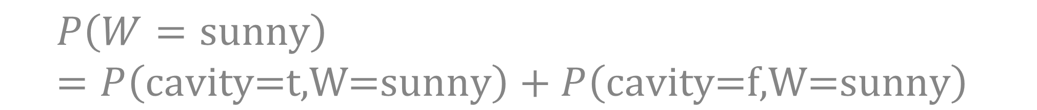
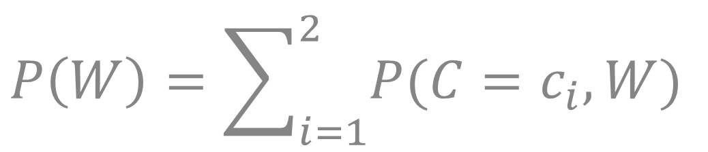
Marginalization
Weather = | sunny | rain | cloudy | snow
Cavity = T | 0.144 | 0.02 | 0.016 | 0.02
Cavity = F | 0.576 | 0.08 | 0.064 | 0.08
Weather = | sunny | rain | cloudy | snow
 | 0.72 | 0.1 | 0.08 | 0.1
$$P\left(W\right)=\sum_{i=1}^{2}{P(C=c_{i},W)}$$
$$P\left(W=\text{sunny}\right)=P\left(\text{cavity}\text{=}\text{t}\text{,}\text{W}\text{=}\text{sunny}\right)+P\left(\text{cavity}\text{=}\text{f}\text{,}\text{W}\text{=}\text{sunny}\right)$$

Slide 4
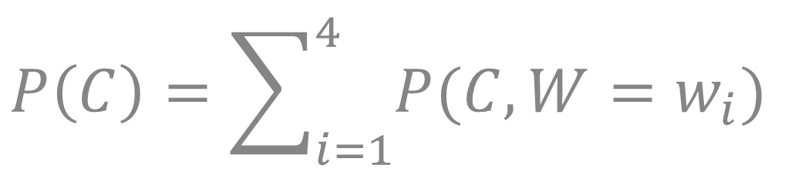
Marginalization
Weather = | sunny | rain | cloudy | snow
Cavity = T | 0.144 | 0.02 | 0.016 | 0.02
Cavity = F | 0.576 | 0.08 | 0.064 | 0.08
Cavity = T | 0.2
Cavity = F | 0.8
$$P\left(C\right)=\sum_{i=1}^{4}{P(C,W=w_{i})}$$

Slide 5
Continuous Densities

Slide 6
Probability of Joint Event

Slide 8
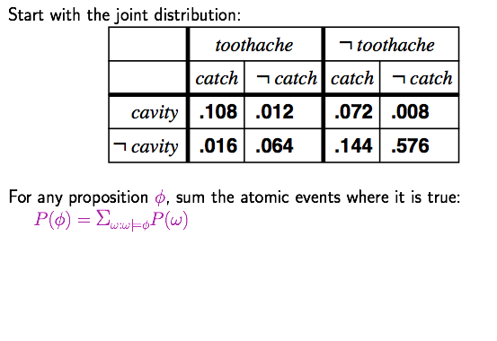
Inference by Enumeration

Slide 9
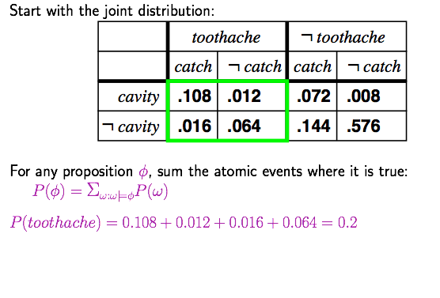
Inference by Enumeration

Slide 10
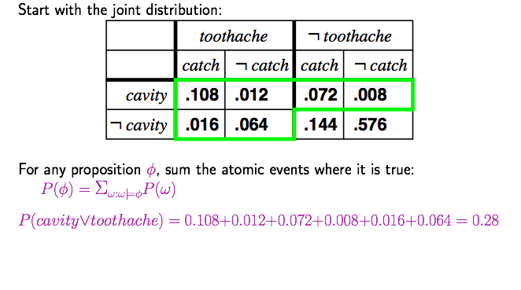
Inference by Enumeration

Slide 11
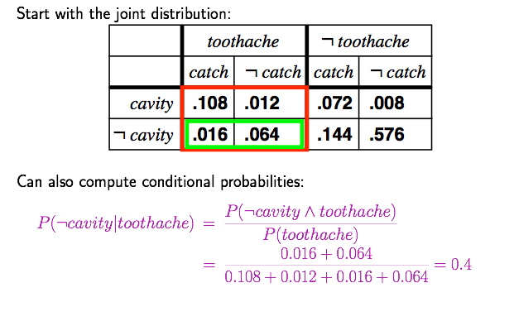
Inference by Enumeration

Slide 12
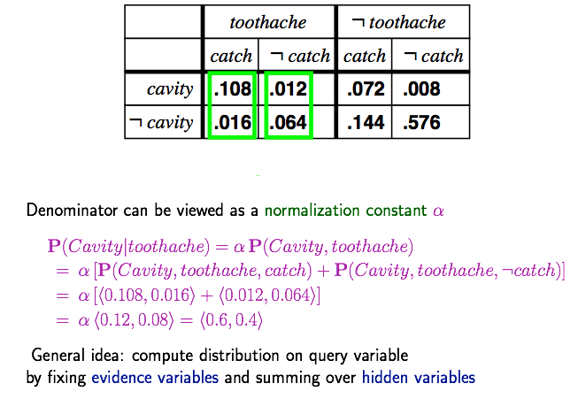
Normalization

Slide 13
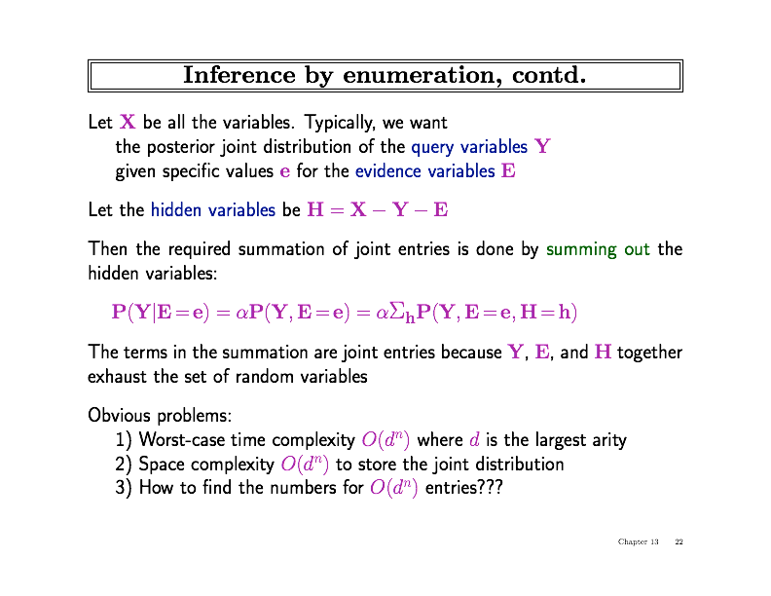
Inference by Enumeration

Slide 14
Inference by Enumeration

Slide 15
Inference by Enumeration

Slide 16
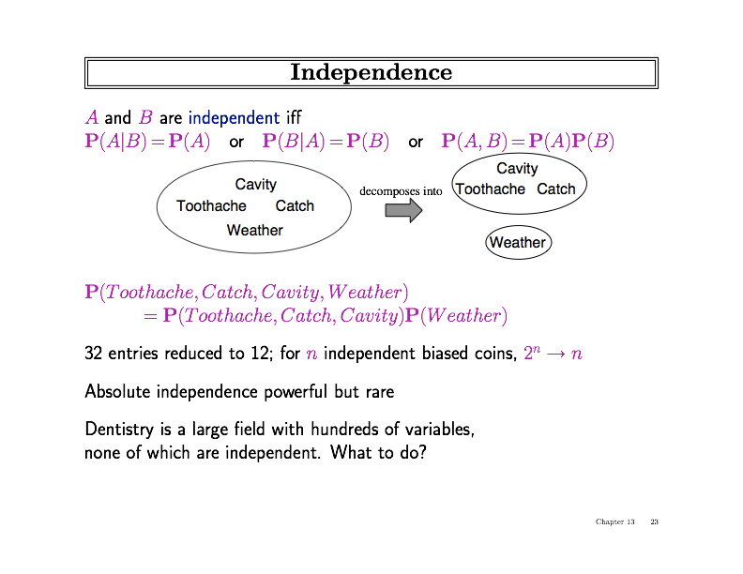
Independence

Slide 17
Independence

Slide 18
Independence

Slide 19
Inference Using Bayes Rule

Slide 21

$$P\left(T\right)=P\left(T,D\right)+P(T,\overline{D})$$

Slide 23

$$P\left(D\right)=0.001$$
After positive test, 9 times more likely to have disease

Slide 30
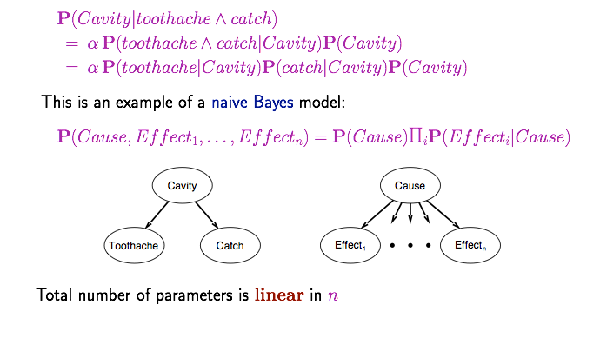
Bayes’ Rule and Conditional Independence

Slide 31
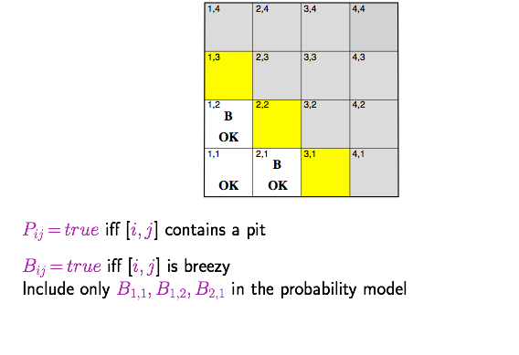
Wumpus Example

Slide 32
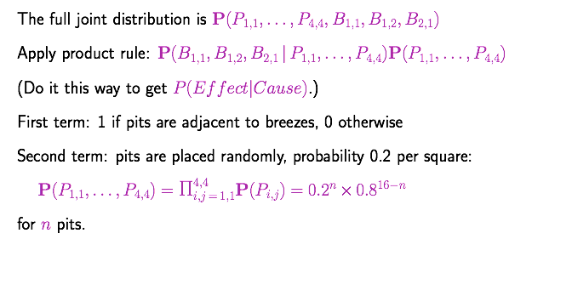
Wumpus Probability Model

Slide 33
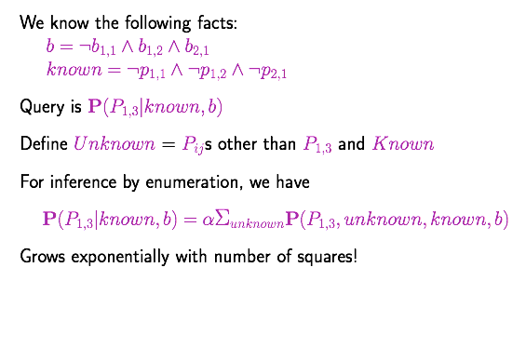
Observations and Query

Slide 34
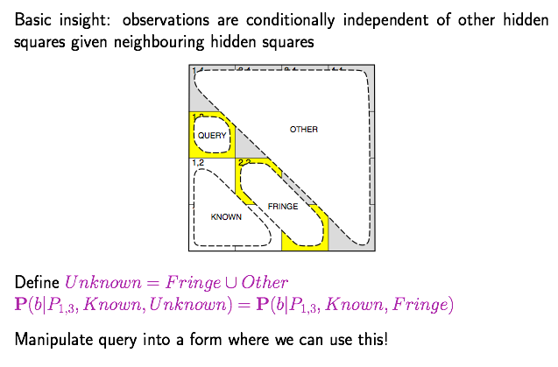
Using Conditional Independence

Slide 35
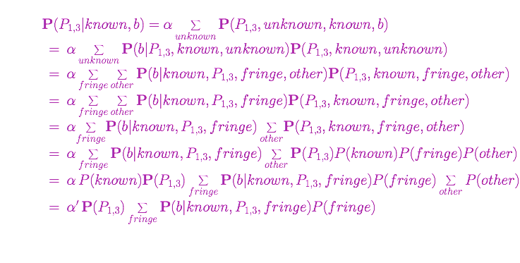
Using Conditional Independence

Slide 36
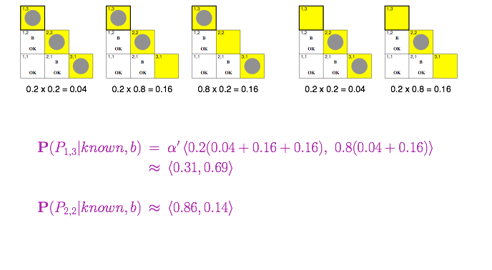
Using Conditional Independence

Slide 37
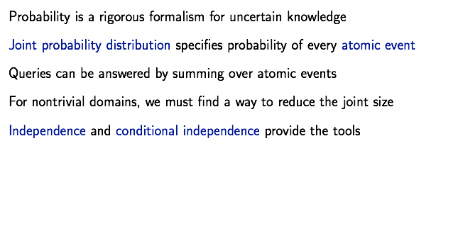
Summary

